Slide 1
ICCF Congress 2023 ICGA Chess Tournaments Valencia 2023
Richard Pijl

Slide 2
Introducing me
56 years old, living in Belgium, married and three daughters
Playing OTB chess since childhood
Playing Correspondence chess at different organizations, at ICCF since 2015. Currently holding CCM title.
Author of the computer chess program The Baron
Notes:
The ICGA Journal provides an international forum for computer games researchers presenting new results on ongoing work. The editors invite contributors to submit papers on all aspects of research related to computers and games. Relevant topics include, but are not limited to:
the current state of game-playing programs for board games, card games, and puzzles,
the current state of virtual, casual, and video games,
new theoretical developments in game-related research,
theoretical and practical work on the design of games and puzzles, and
general scientific contributions produced by the study of games.
Also welcome is research on topics such as:
social aspects of computer games,
cognitive research of how humans play games,
capture and analysis of game data, and
issues related to networked games are invited to submit their contributions.
ACG is an internationally renowned conference that publishes computer-based studies of games. Its history goes back to the inaugural event held in Edinburgh in 1975, making this the longest ongoing game AI conference.
Computer and Games features cutting edge artificial intelligence technology as applied to computer games.
“Computer Olympiad, aiming at the competition of games, provides a stage of technical communication for those who are interested in artificial intelligence of computer games.”
“To promote the research, development, application, and communication of game-playing programs and the related realms.”
Amazons, Breakthrough, Chinese Dark Chess, Honeymoon Bridge, Chinese Checkers, Clobber, Connect6, Dots and Boxes, EinStein Würfelt Nicht, International Draughts, Go (9×9), Gomoku (Outer-Open), Havannah (8×8), Hex (13×13), Hex (19×19), Mahjong, Mini Shogi, Nonogram, Othello (8×8), Othello (10×10), Outer-Open Gomoku, and Surakarta.

Slide 3
What is the ICGA
To advance the state of the art in artificial intelligence as demonstrated using games
ICGA Journal
Conference ‘Advances in Computer Games’
Conference ‘Computers and Games’
Computer Olympiad
World Computer Chess Championship
Notes:
The ICGA Journal provides an international forum for computer games researchers presenting new results on ongoing work. The editors invite contributors to submit papers on all aspects of research related to computers and games. Relevant topics include, but are not limited to:
the current state of game-playing programs for board games, card games, and puzzles,
the current state of virtual, casual, and video games,
new theoretical developments in game-related research,
theoretical and practical work on the design of games and puzzles, and
general scientific contributions produced by the study of games.
Also welcome is research on topics such as:
social aspects of computer games,
cognitive research of how humans play games,
capture and analysis of game data, and
issues related to networked games are invited to submit their contributions.
ACG is an internationally renowned conference that publishes computer-based studies of games. Its history goes back to the inaugural event held in Edinburgh in 1975, making this the longest ongoing game AI conference.
Computer and Games features cutting edge artificial intelligence technology as applied to computer games.
“Computer Olympiad, aiming at the competition of games, provides a stage of technical communication for those who are interested in artificial intelligence of computer games.”
“To promote the research, development, application, and communication of game-playing programs and the related realms.”
Amazons, Breakthrough, Chinese Dark Chess, Honeymoon Bridge, Chinese Checkers, Clobber, Connect6, Dots and Boxes, EinStein Würfelt Nicht, International Draughts, Go (9×9), Gomoku (Outer-Open), Havannah (8×8), Hex (13×13), Hex (19×19), Mahjong, Mini Shogi, Nonogram, Othello (8×8), Othello (10×10), Outer-Open Gomoku, and Surakarta.

Slide 4
What are the ICGA Chess Tournaments
There are three Chess Tournaments, only open to authors of original chess programs:
World Computer Chess Championship Open Hardware
World Chess Software Championship Identical hardware platforms (AMD Ryzen 7 3700x (8 cores))
World Computer Speed Chess Championship Open Hardware, short time control

Slide 5
Who are the participants in 2023
Arasan, by Jon Dart
Jonny, by Johannes Zwanzger
Fritz, by Frank Schneider (Ginkgo)
Stoofvlees, by Gian-Carlo Pascutto (Deep Sjeng/Leela Go)
AMD Threadripper 32 cores
100 x AMD EPYC (32 cores)
AMD EPYC 2x 96 cores, 1.5TB RAM
AMD Threadripper 1x64 cores, 4x nVidia RTX 4090
Notes:
Arasan is around for almost 30 years and is a free and opensource program. This tournament is its debut.
Jonny has been participating in the WCCC since 2003 when the tournament was organized in Graz. It usually runs using a big university cluster providing thousands of cores. Jonny has been a world champion in 2015 before e.g. Komodo, Hiarcs and Ginkgo.
Fritz (formerly known as Ginkgo) is participating in the WCCC since 2015. Frank participated with his previous program Gromitchess in the WCCC 1999. Ginkgo was the reigning WCSC champion of 2022
Stoofvlees is also new for the WCCC although the previous program of Gian-Carlo (Deep Sjeng) participated in earlier WCCCs

Slide 6
Findings from the 2022 Tournament in Vienna
The Draw rate is becoming very high among the top programs
Playoff matches are not very useful due to the draw rate
Armageddon games are a win for black.

Slide 7
Experiences in other tournaments - TCEC
TCEC (‘Thoresen Chess Engine Competition’ or ‘Top Chess Engine Championship’)
Plays without book and learning features but with pre-set positions, initially to prevent repeated games
Matthew Sadler in NIC Yearbook 141:
‘A match between Leela and Stockfish from the normal starting position would most likely end in 100 draws’
Notes:
TCEC uses a number of restrictions:
No opening books allowed
No position learning features allowed, i.e. the engines use the same knowledge in all games and do not evolve during the tournament
No bug-fixing during the tournament
No pondering
Typically laying on the same machine
But plays many games

Slide 8
Changes in the 2023 Tournament in Valencia
Reduce the time control to play double the rounds
In Playoffs for first place use pre-set positions

Slide 9
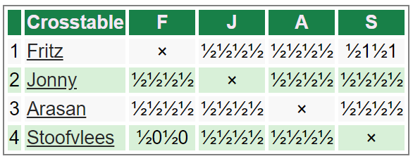
World Chess Software Championship - Results
The Stoofvlees operator (Erdogan Günes) chose sidelines to attempt to win with black (Caro-Kan and Dutch)
Stoofvlees requires a good GPU make the best of its neural network.
Notes:
This is similar to the results of Leela in Vienna

Slide 10
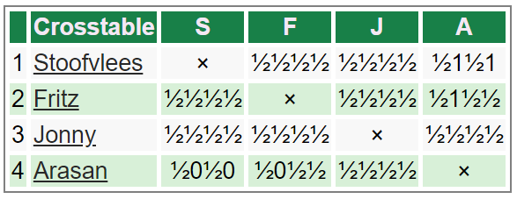
World Computer Chess Championship - Results
Arasan ran on the weakest hardware (32 vs 184 cores for Fritz)
Still difficult to beat it, requires creativity in book-line selection
Notes:
This is similar to the results of Leela in Vienna

Slide 11
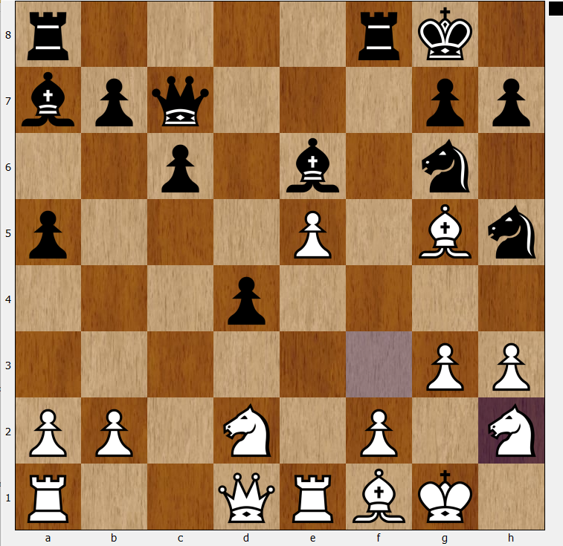
Game Position Fritz - Stoofvlees
Last move by Fritz: 20.Nh2
Stoofvlees responded 20..Rxf2!?
Very complicated play and very entertaining.
But only if you do not look at the engine scores
https://youtu.be/qqVU6aSF8I0
Notes:
Albert Silver posted a video on this game

Slide 12
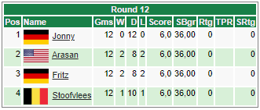
World Computer Speed Chess Championship - Results
After 12 rounds:
Tournament rules did not foresee in this situation.
It was decided to add another cycle of 3 2-game rounds but considering this a playoff: With preset positions
Position randomly selected from set of sealed envelopes
3 different positions used
Notes:
Wins for major part due to operator errors

Slide 13
World Computer Speed Chess Championship - Results
Conclusion:
More decisive games
Games were unbalanced longer, even when still ending in a draw
Notes:
This is similar to the results of Leela in Vienna

Slide 14
Observations in the 2023 Tournament in Valencia
Playing main lines is a draw
Playing tricky lines probably still is a draw, but may deliver the occasional win
Using slightly off-set positions makes computer chess interesting again.
Notes:
Jonny played 36 draws without any excitement by playing main lines
Playing well-analyzed sidelines with little theory (e.g. 1.b3 as played by Stoofvlees) is

