Slide 1
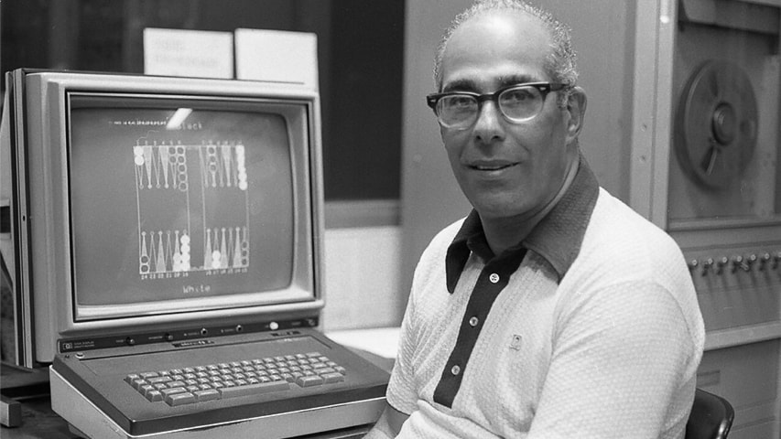
Hans Jack Berliner
Berlin, Germany Jan 27, 1929

Slide 2
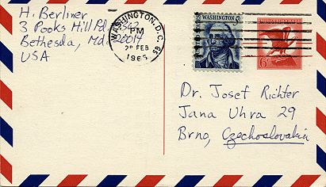
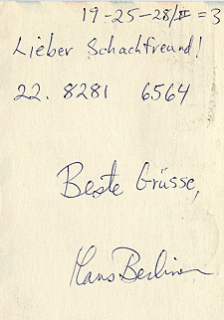
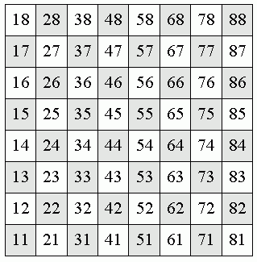
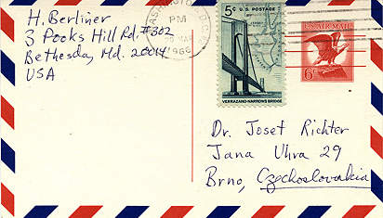
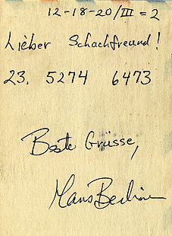
Josef Richter – Hans Berliner
5th CC World Championship Final
22. Kh1 f4 (20 Feb 1966)
23. Bg4 fxg3 (20 Mar 1966)

Slide 3
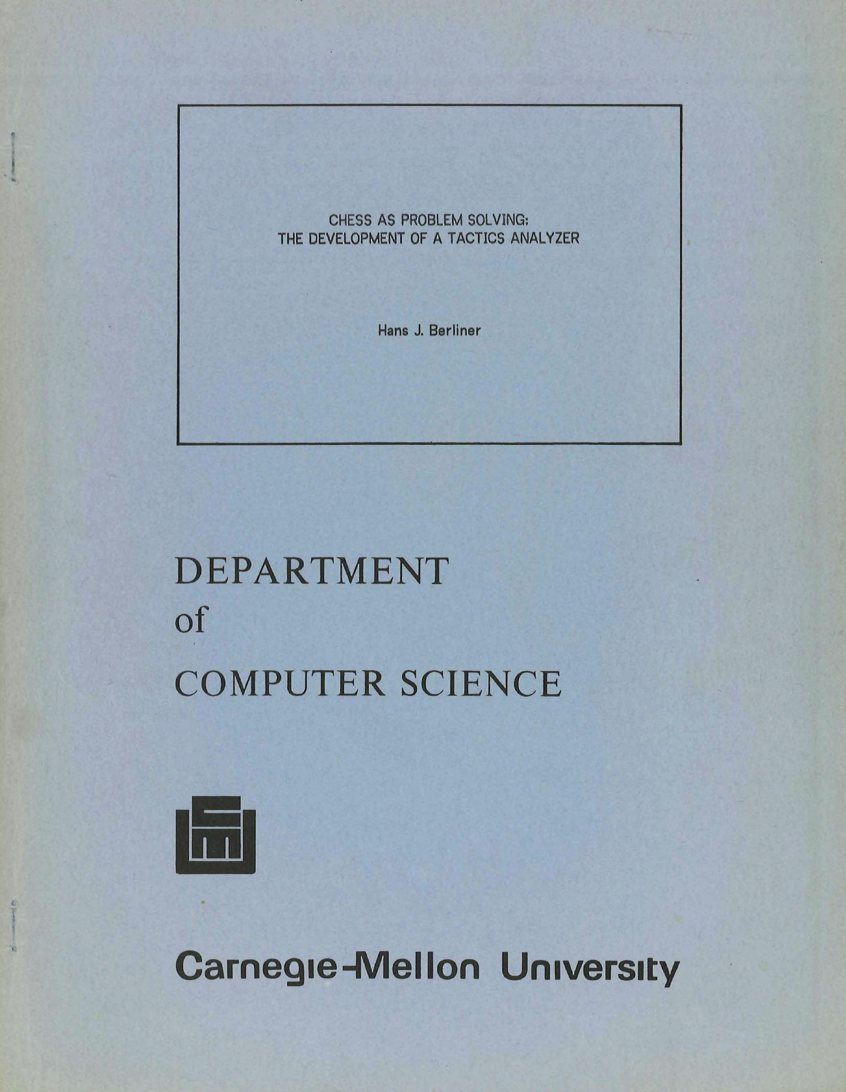
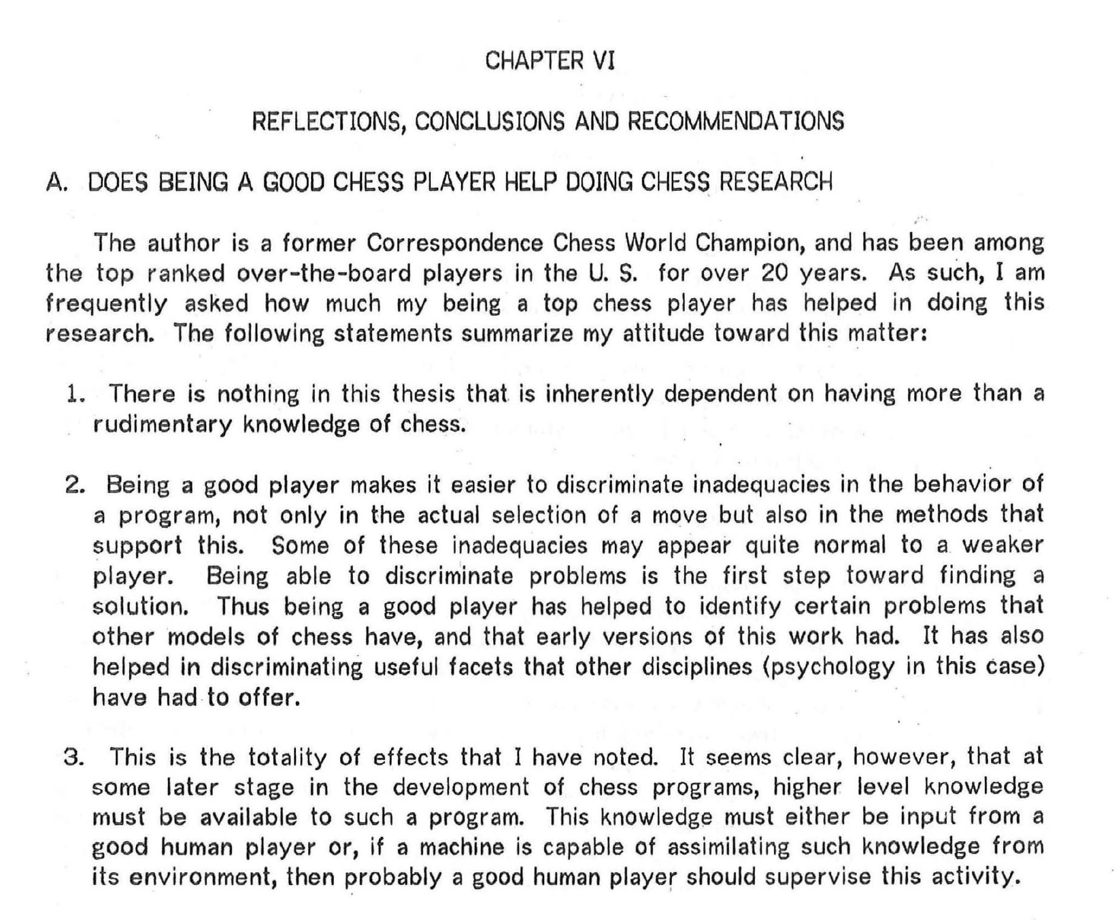

Slide 4
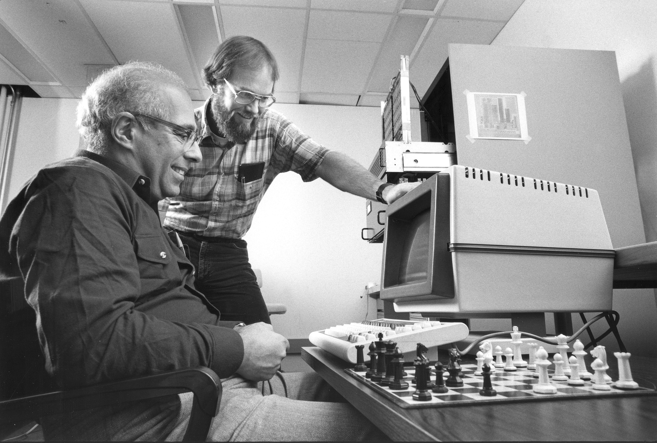
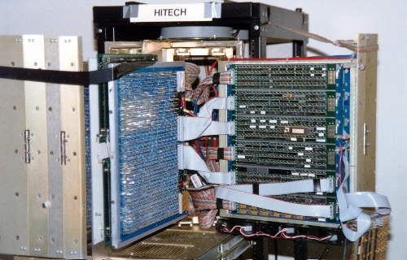
Hans Berliner and Carl Ebeling
(Carnegie Mellon University, 1985)

Slide 5
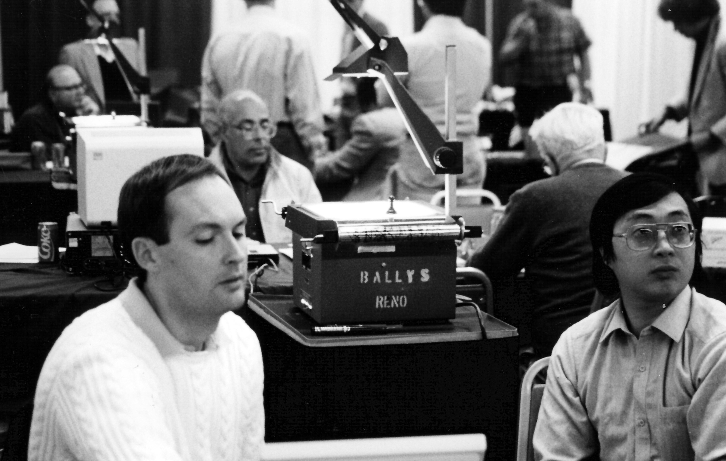
Murray Campbell, Feng-hsiung Hsu and Hans Berliner
(ACM Tournament, Reno 1989)

Slide 6
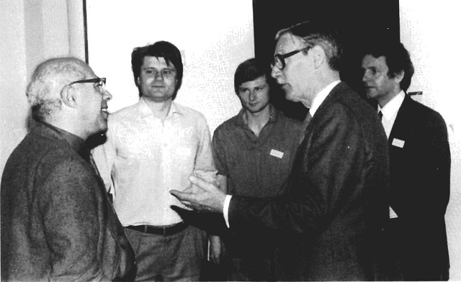
Hans Berliner and A.D. de Groot
(Advances in Computer Chess 5 Conference, Noordwijkerhout, NL, April 1987)

Slide 7
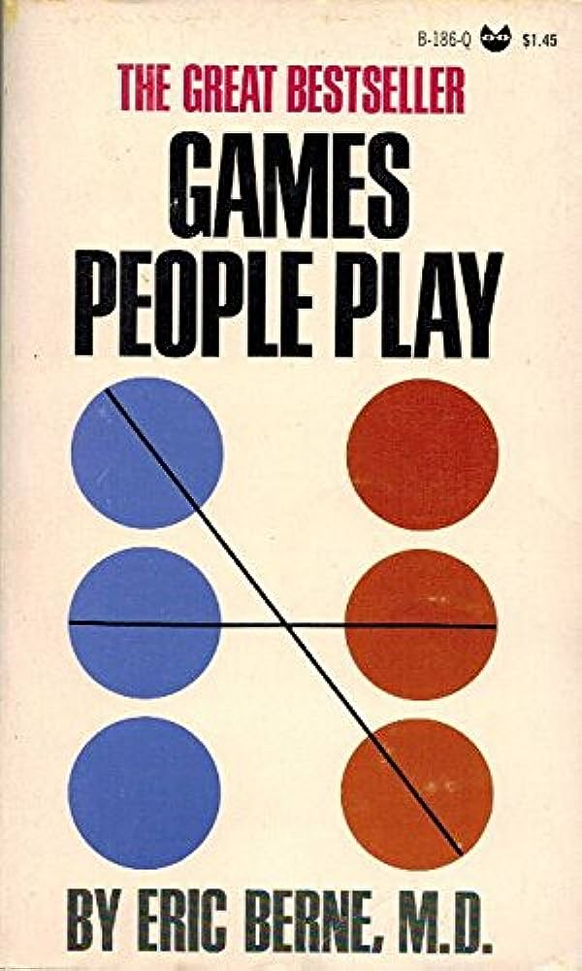

Slide 8
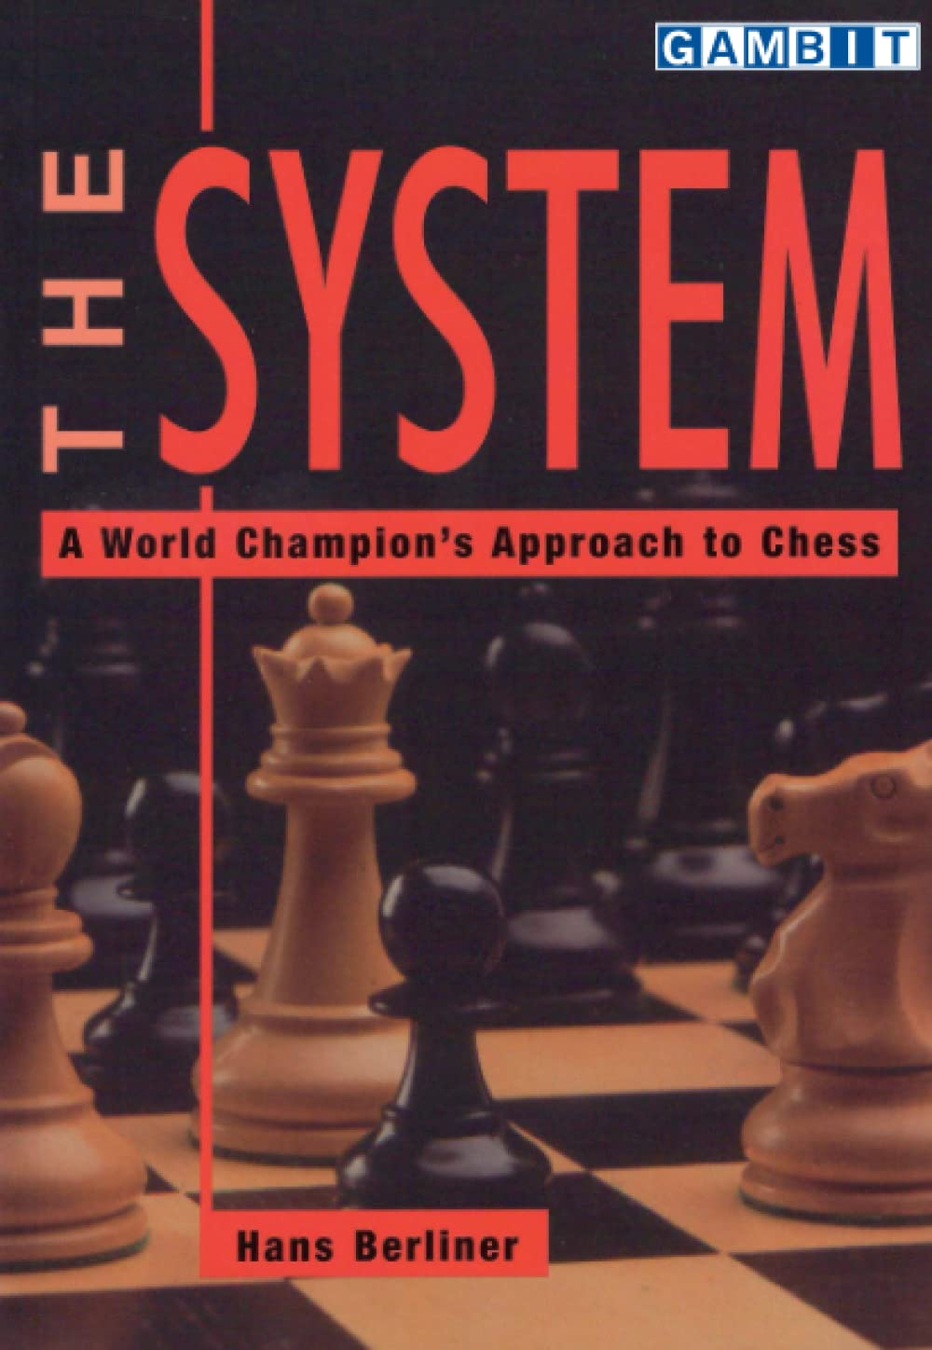
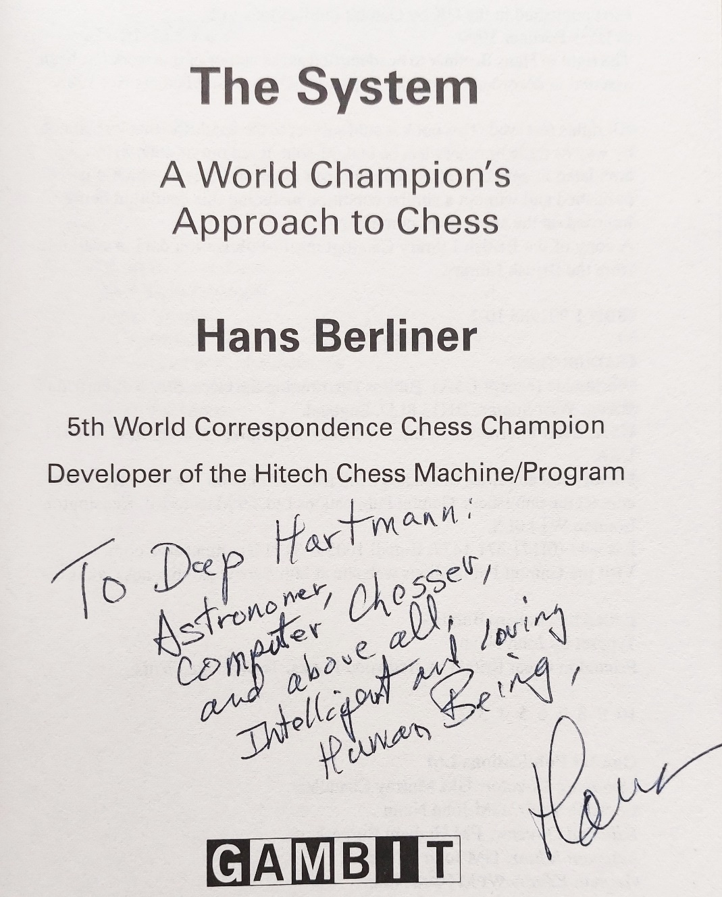

Slide 9
The System Principles
2. Piece Location
Each piece has an optimum location, and possibly several near-optimum
locations. It is important to determine these locations early in the play,
and try to get each piece to its optimal location.
3. Development
Pieces should be brought to their optimal location by moving each piece
only once, although in the case of Knights it may be permissible to move
a Knight twice if the second move is to a centre square.
4. Board Control : Attack and Control the Centre
The centre should be attacked by Pawns supported by pieces.
5. Options
Make the move (develop the piece) which does the least to reduce
your options to make other important moves.

Slide 10
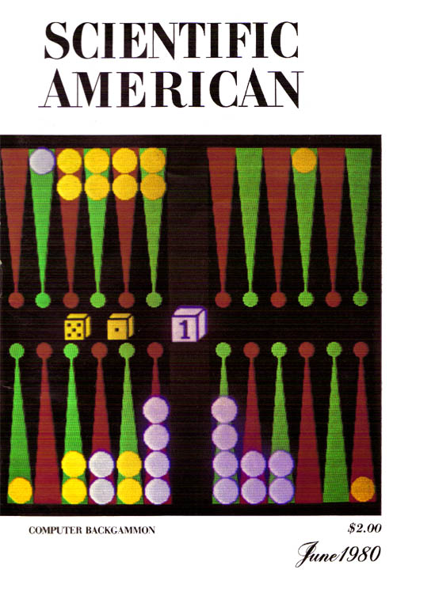
Backgammon
‘The thing that makes backgammon an interesting object of study of AI is that in any given position (of which are 1020), there are 21 possible combinations that the throw of two dice can produce.
Each of these can be played legally in the average board position about 40 different ways. Thus if one were to investigate a backgammon position by tree searching, it would be necessary to deal with a branching factor of more than 800 (!!) at every node.’
Hans Berliner (1977)

Slide 11
SuperPuzz

Slide 15
X

Slide 18
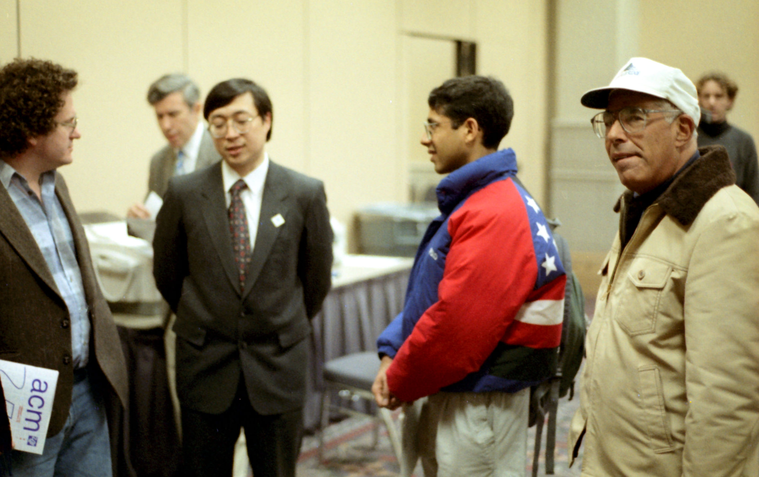
Hans Berliner (Philadelphia 1996)

Slide 19
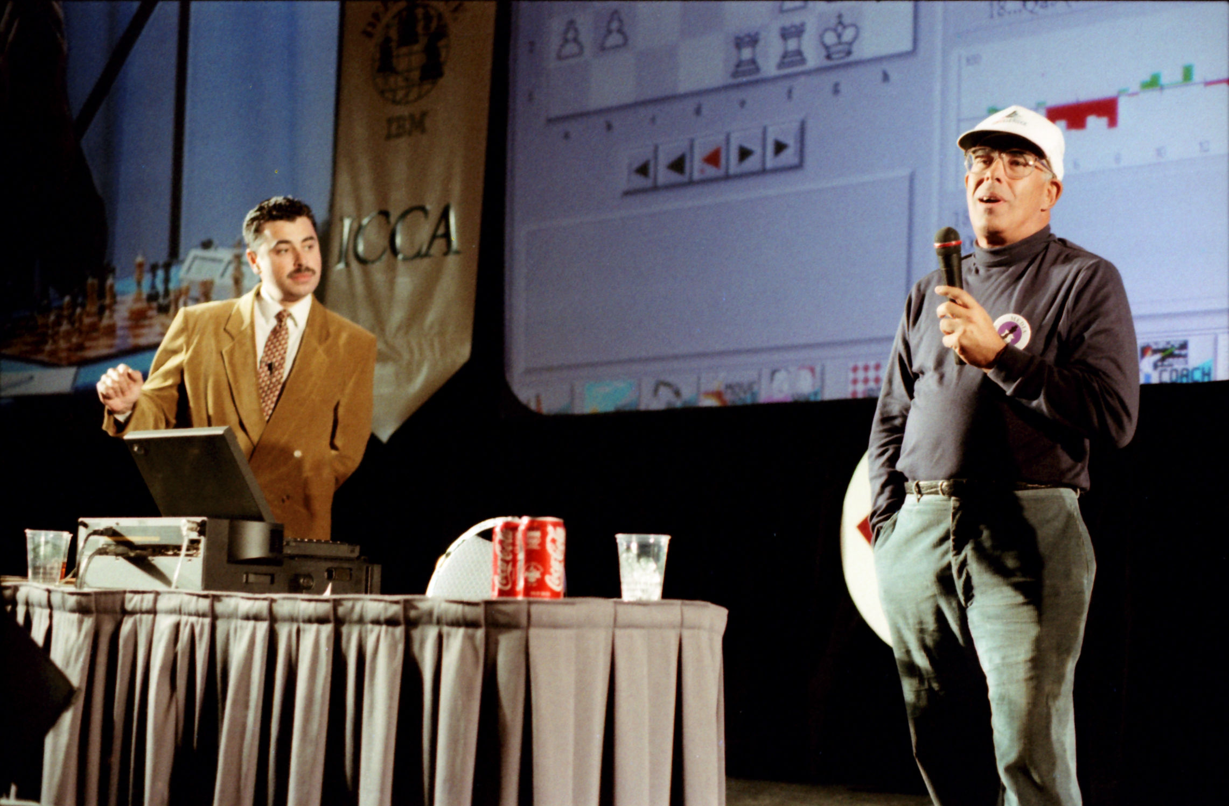
Hans Berliner and Yasser Seirawan (Philadelphia 1996)

Slide 20
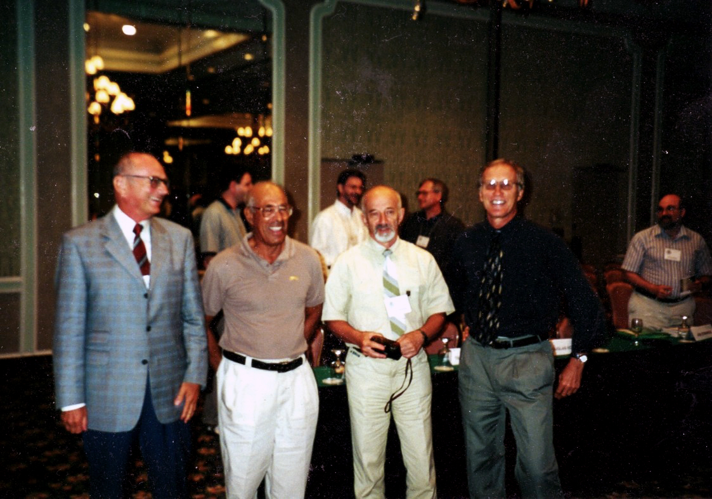
Hans Berliner and Jon Edwards (Daytona Beach 2000)
(Photo Credits: Jon Edwards)

Slide 21
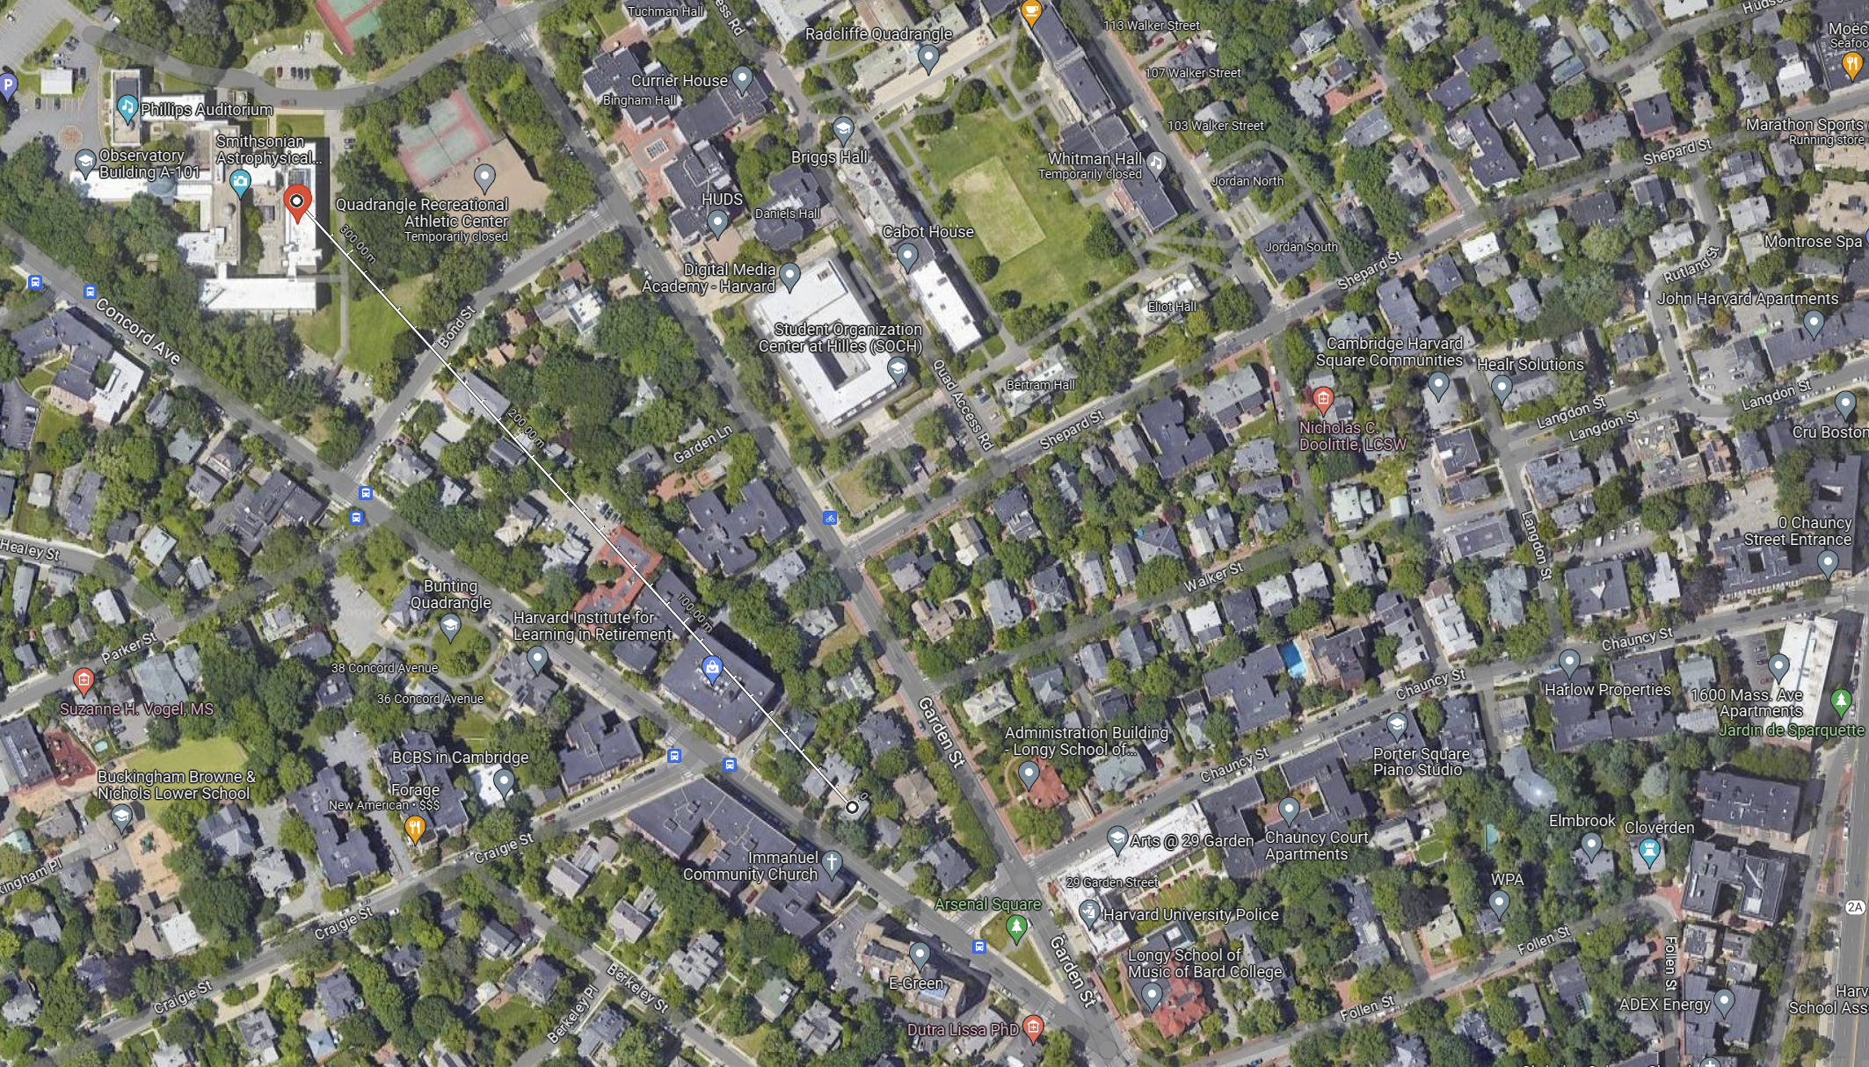

Slide 22
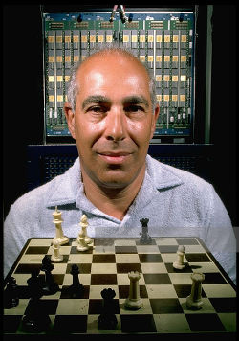
† Jan 13, 2017
River Beach, FL
(aged 87)

